Slide 1

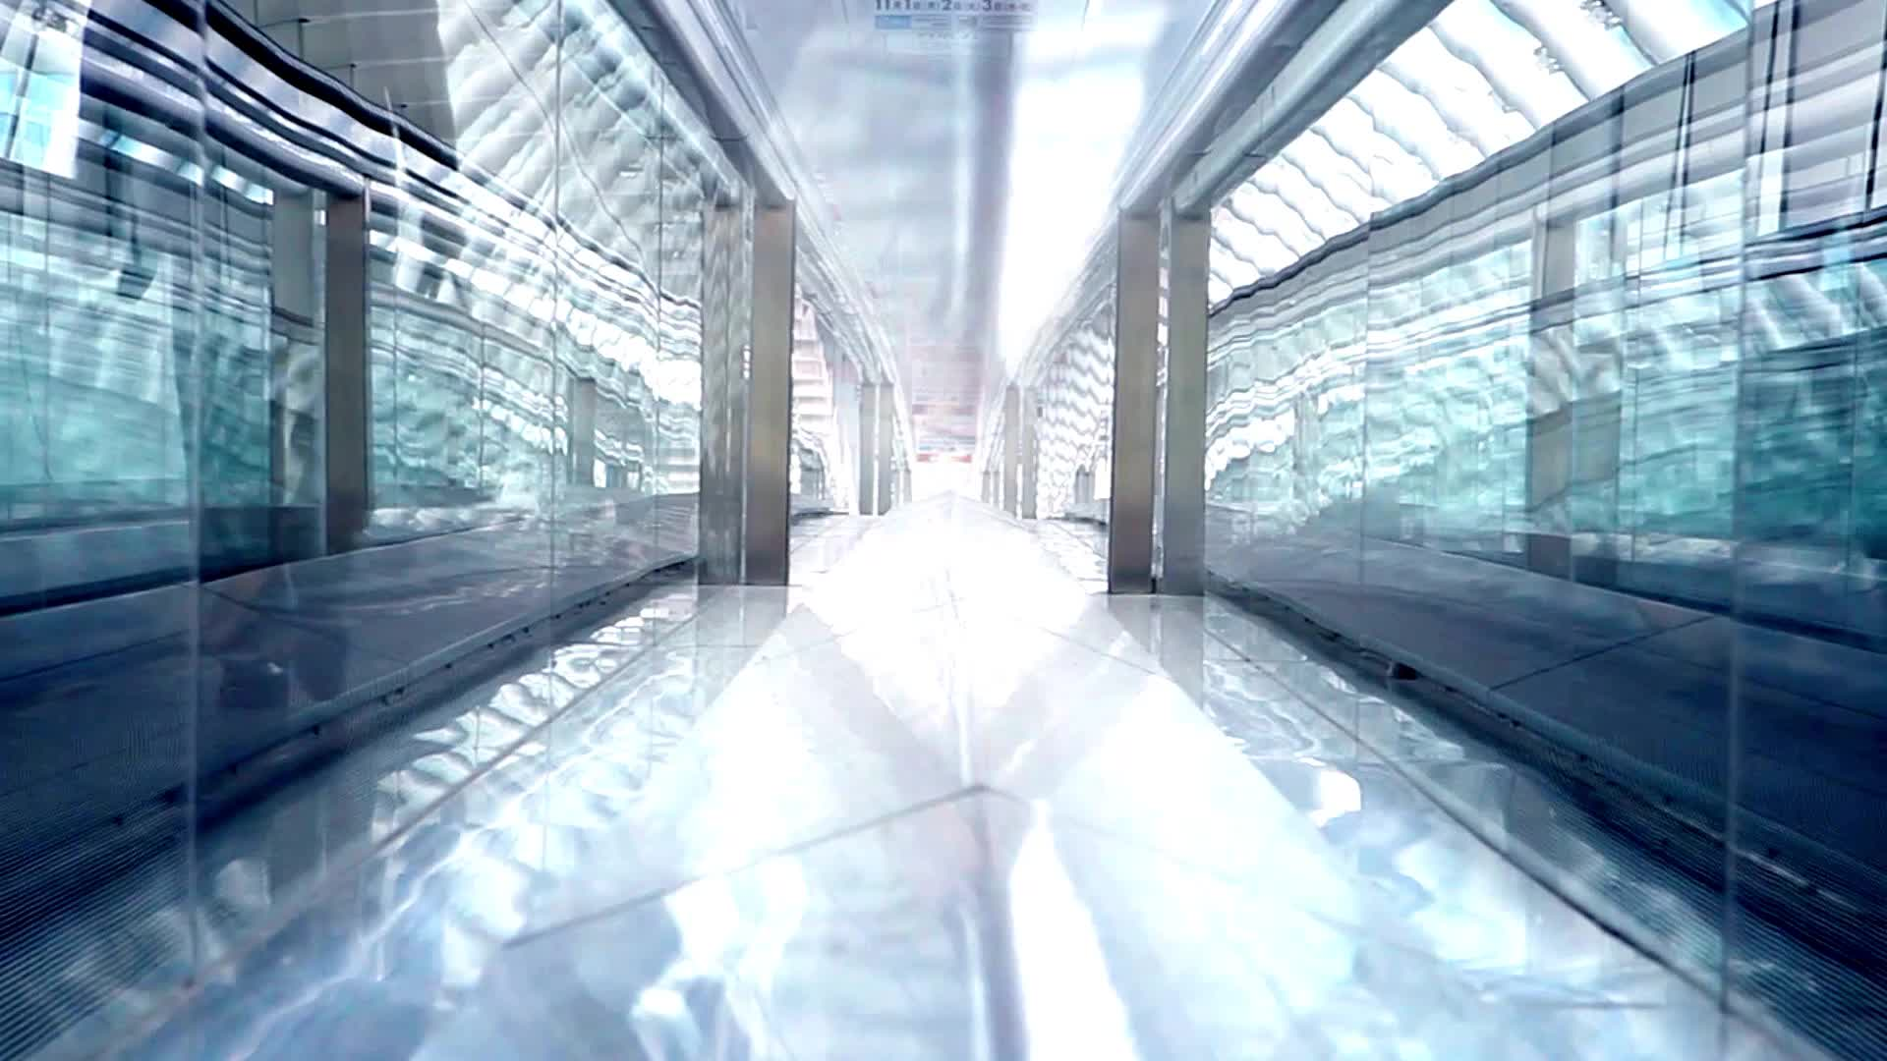
GoTrash
Go trash or go home

Slide 2
SUMMARY
Introduction
Team
Organisation
GoTrash
Feedback
Gained skills
Questions

Slide 3
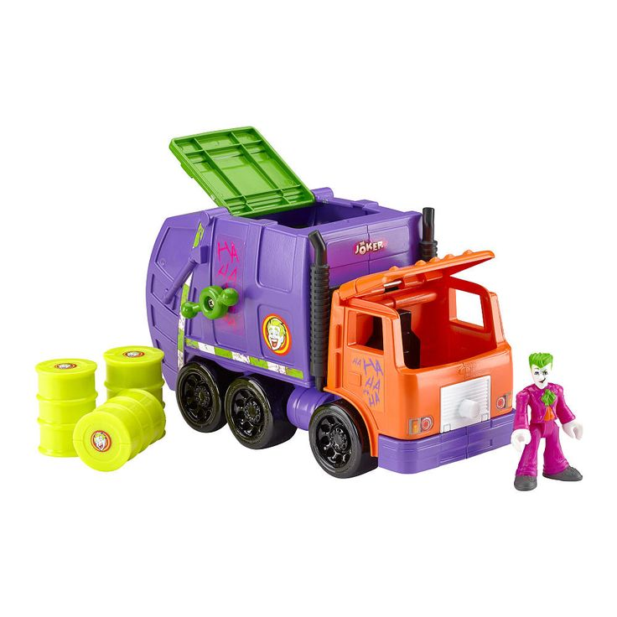
INTRODUCTION
GoTime: a time manager application
GoGPS: GPS trackers on trucks
GoTablet: a tablet for all employees
GoDrones: drones for surveillance
GoCaptors: captors on all trash cans
GoReport: an application for reporting incidents and asking for sanitation services
GoWork: a monthly reporting of the performance

Slide 4


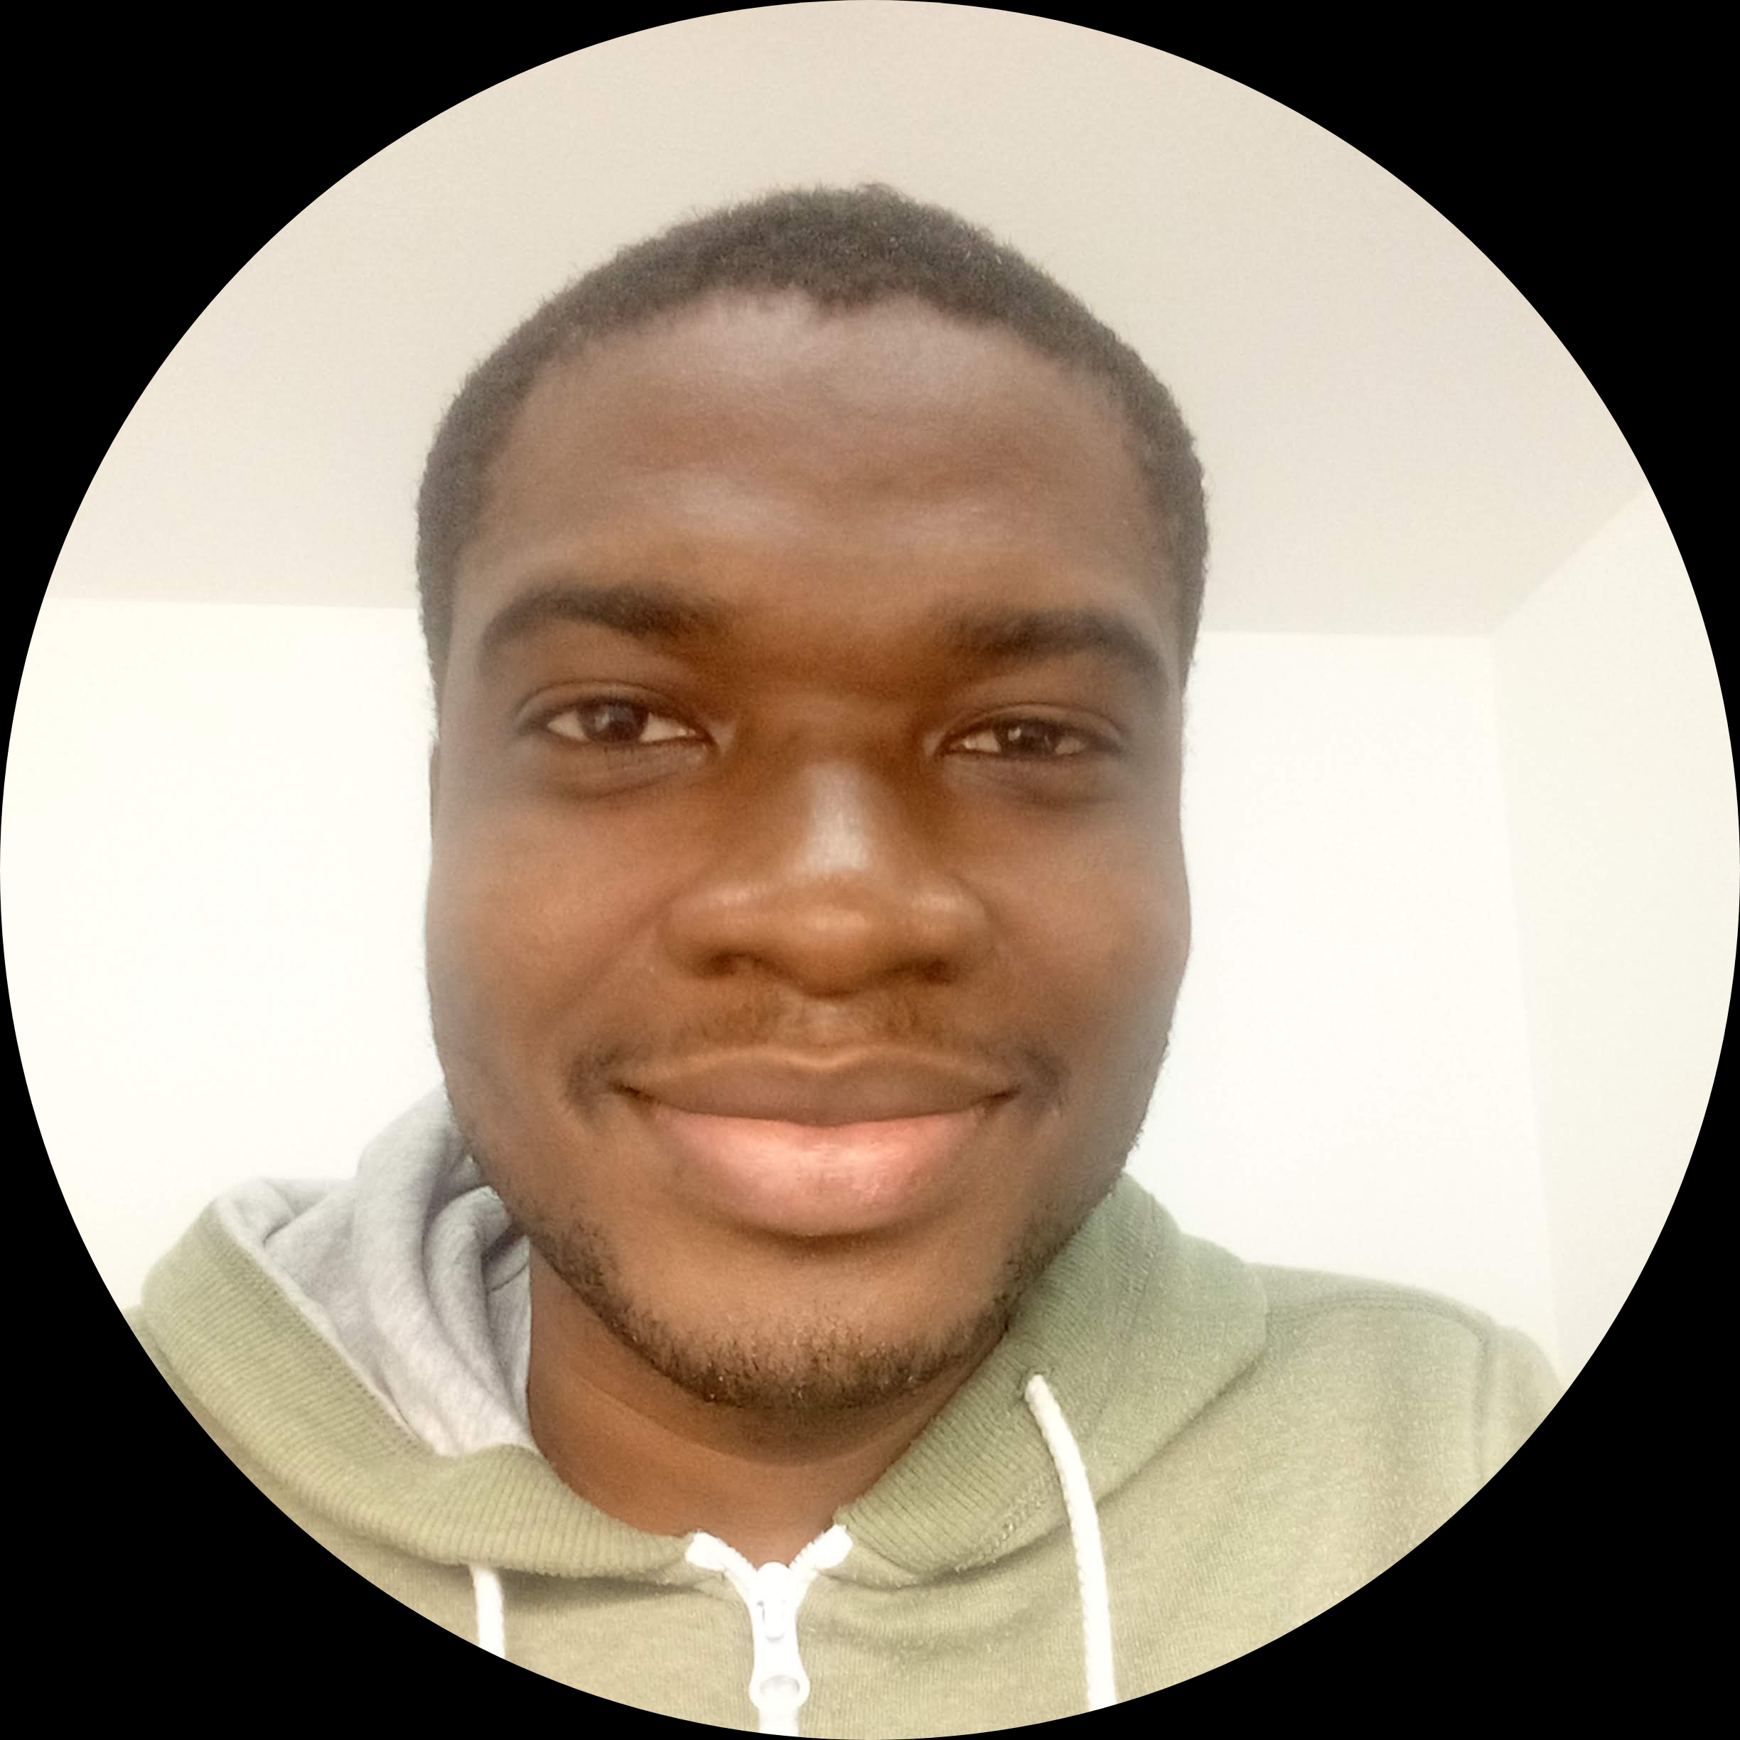
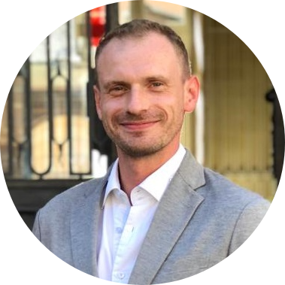
TEAM
Kotchénin Kosson FANIDJI KASSIGNI
Johan-David DEHI
Anthony BARNOIN
Grégory KOENIG
Change manager
Change manager
Change manager
Change manager

Slide 5






ORGANISATION
Google Drive
Discord
Miro
Microsoft Teams
Microsoft OneDrive
GitHub

Slide 6
GoTrash - Need
SWOT analysis
What to change
S
W
What to change?
strength
weakness
O
T
oportunity
threat

Slide 7
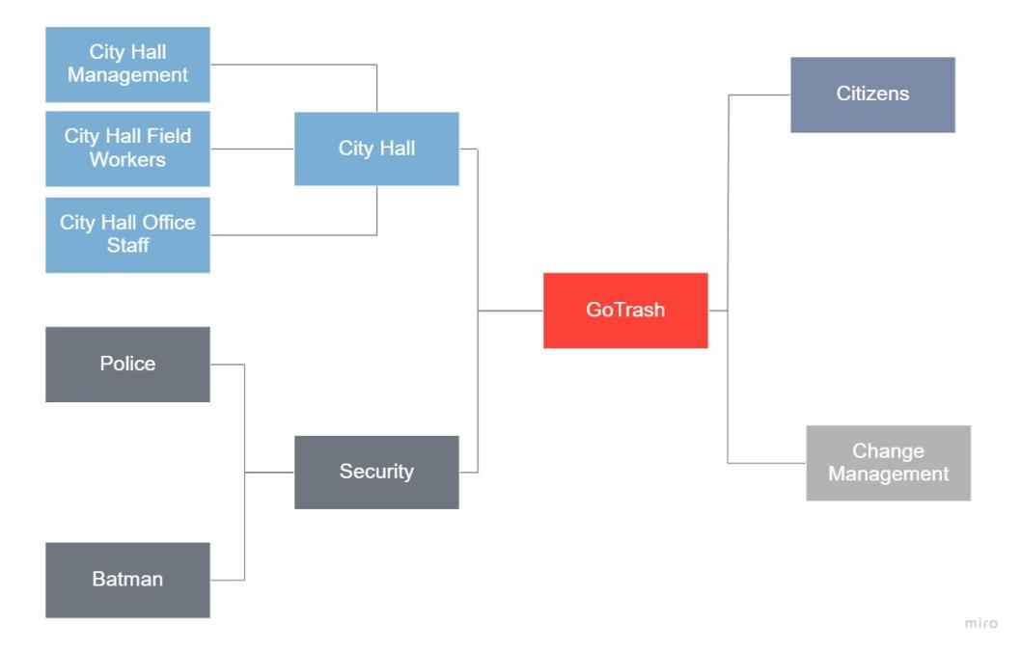
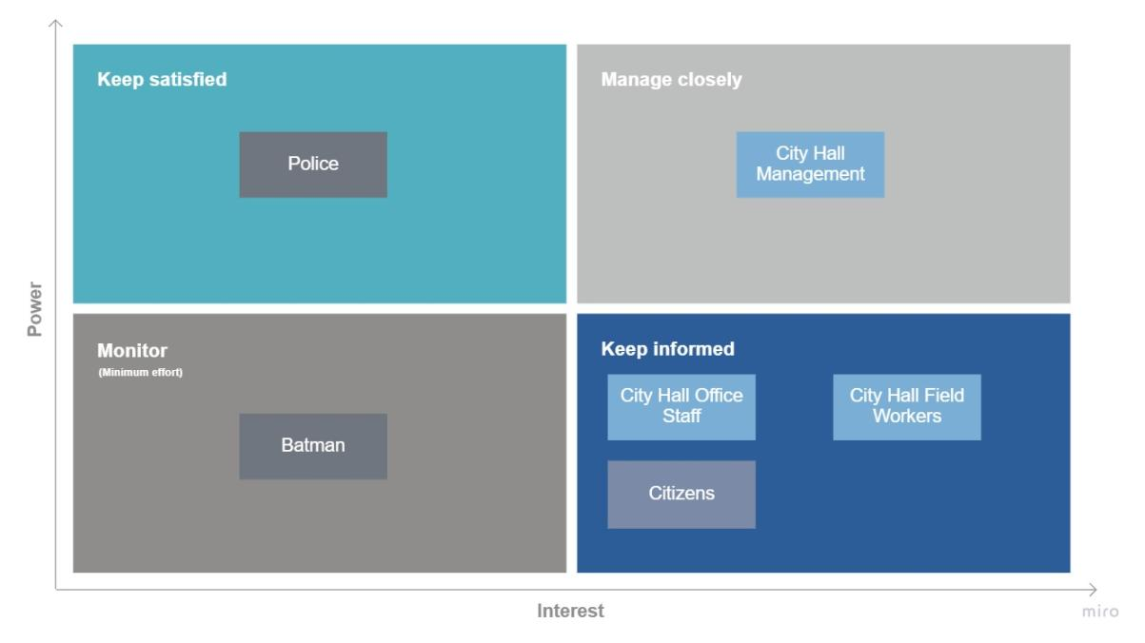
GoTrash - Identify
Stakeholders mapping :
- Identifying all stakeholders (actors) part of the project
- Categorizing the stakeholders according to their role and position

Slide 8

GoTrash - Design
Phase | Description | Objectives
1 | Preparing for change | Define change management strategy Prepare change management teams Develop sponsorship model
2 | Managing change | Develop change management plans Take actions and implement plans
3 | Reinforcing change | Collect and analyse feedback Diagnose gaps and manage resistance Implement corrective actions Celebrate successes

Slide 9
GoTrash - Coach
SPONSORS FOR CHANGES
Prove what will be better after the changes
Comfort people to the change
ROLE OF MANAGEMENT
Communicator
Advocate
Coach
Liaison
Resistance Manager

Slide 10



GoTrash – Management: Communication plan
Stakeholders-based approach (following Prosci's Change Management Process)
Meetings
Teaching
Interviews

Slide 11

GoTrash – Employees: Communication plan
A conference will be organized and employees will be informed by:
Team meeting
Posters
E-mail
Flyers

Slide 12







GoTrash – Police: Communication plan
Stakeholders

Slide 13





GoTrash – Citizens : Communication plan
Communicate about changes
Explain why this change
Counteract conspiratorial arguments

Slide 14
FEEDBACK
Handling two simultaneous projects on a short deadline
Tackling a subject without prior knowledge of it
Remote work
Facing organization difficulties
Ability to solve any issue encountered

Slide 15
GAINED SKILLS
Setting up a change
The role of communication in change management
Best practice to implement change
Learning to work with unknown students
Producing documentations

Slide 16

QUESTIONS

Slide 17

THANKS

